Slide 1
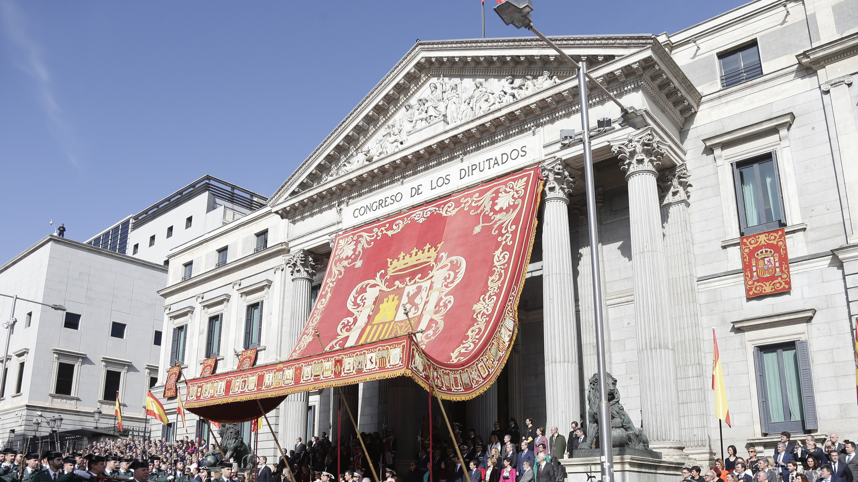
The new green books
Transforming our services to support the process of law-making in today's Parliament

Slide 2
Historical introduction (1983-2020)
This task was carried out by collecting, gathering and giving access to a set of documents -national, foreign and international law, complementary documentation and studies-, with a fixed arrangement or structure
The first dossiers
1983: "Comunidades autónomas"

Slide 3
Evolution until 2020
Historical introduction
Permanent feautures
Main variations
Function and goal
Structure
Outreach pursuit
Colour
New contents
Electronic edition
Outreach methods

Slide 4
One basic goal
Historical introduction
Permanent features
Provide an informational base for the parliamentary law-making procedure of bills
Authoritative
Specialized
Concise
Impartial
Timely

Slide 5
A fixed arrangement or structure
Historical introduction
Permanent features
Reports and impact assessments accompanying the bill (sent by the Government)
Spanish documentation: national and regional legislation, case-law and other supplementary references
Documentation of the European Union: primary and secondary legislation, non-legislative acts, reports...
Foreign law and documentation
Documentation of International Organizations
Bibliography, research studies, main references...
7th term, n. 174 (2004)
Gender violence
12th term, n. 20 (2018)
Intellectual Property

Slide 6
Outreach and distribution pursuit
Historical introduction
Permanent features
Inside the House
Outside of Congress
Recipients: Deputies,
staff of Congress
Time: deadline for submitting amendments
Recipients: different public bodies and institutions; citizens

Slide 7
One colour: green books
Historical introduction
Permanent features

Slide 8
Changes in content and edition
Historical introduction
Principal variations
A new template
and format
Adopted in the 10th term
(2011-2016)

Slide 9
Changes in content and edition
Historical introduction
Principal variations
New presentations
Adopted in the 10th term
(2011-2016)
Brief explanations and commentaries of:
10th term, n. 1.
Financiación de los partidos políticos
The main points of the bill
The series of documents that are included in the dossier
12th term, n. 1.
Contratos del sector público
14th term, n. 1.
Fomento del ecosistema de las empresas emergentes

Slide 10
Changes in the distribution and publication methods
Historical introduction
Principal variations
Web (intranet)
CD-ROM
Public website
Adopted in the 8th term
(2004-2008)
Transparency portal

Slide 11
2020: New transformations
The impact caused by the pandemic led to a critical reflection and reevaluation of the working methods.
As a result, several changes were introduced with the aim of improving and adapting them to the new needs and rhythms of parliamentary life.
Urgency,
shorter deadlines
Working
documents
General speed and
time pressures of
parliamentary life
New dossiers
Open parliament and
outreach to citizens
New publicity

Slide 12
Working documents
Studies
Accompanying documentation
(documents sent by the government along with the bill)
Comparative texts
( legislative changes proposed in the bill)

Slide 13
Legislative transformations:
brevity of deadlines
Working documents
Increase in the rate of urgent procedures and briefer parliamentary deadlines
Parlamentarians need all the basic documental support to study bills, submit amendments and prepare their debates as soon as possible
Rate of urgent procedure for bills
(with a deadline of eight days for submitting amendments, as opposed to a deadline of fifteen days in the ordinary legislative procedure)
1978-2023

Slide 14
Origin of the working documents (WD)
Working documents
Elements or parts of the dossiers that were asked for more urgently by our users
Accompanying documentation WD
(documents sent by the government along with the bill)
Comparative texts WD
( legislative changes proposed in the bill)
Studies WD

Slide 15
Timing of the elaboration and distribution of the Working documents
Working documents
The WD are prepared in advance and made available amost simultaneously with the publication of the bill in the Official Gazette of the Spanish Parliaments
Inside the House
Outside of Congress
Recipients: those deputies and
staff of Congress in charge of the procedure of the bill
Time: almost simultaneously with the publication of the bill in the Official Gazette of the Spanish Parliament
Recipients: citizens
The Working Documents are finally included in the dossier and published in the website of Parliament

Slide 16
Contents: general features
Working documents
Incorporation of the record or file number
In all the working documents the name of the bill is accompanied by the file or record number that is used to identify the legislative procedure of that particular initiative through all its stages
Inclusion of QR codes

Slide 17
Accompanying documentation
Working documents
Impact evaluation assessments
Reports from advisory bodies (i. e. Council of State), public bodies and agencies, etc.
Reports from the Ministerial Departments...
Accompanying documentation WD
Right of defense bill

Slide 18
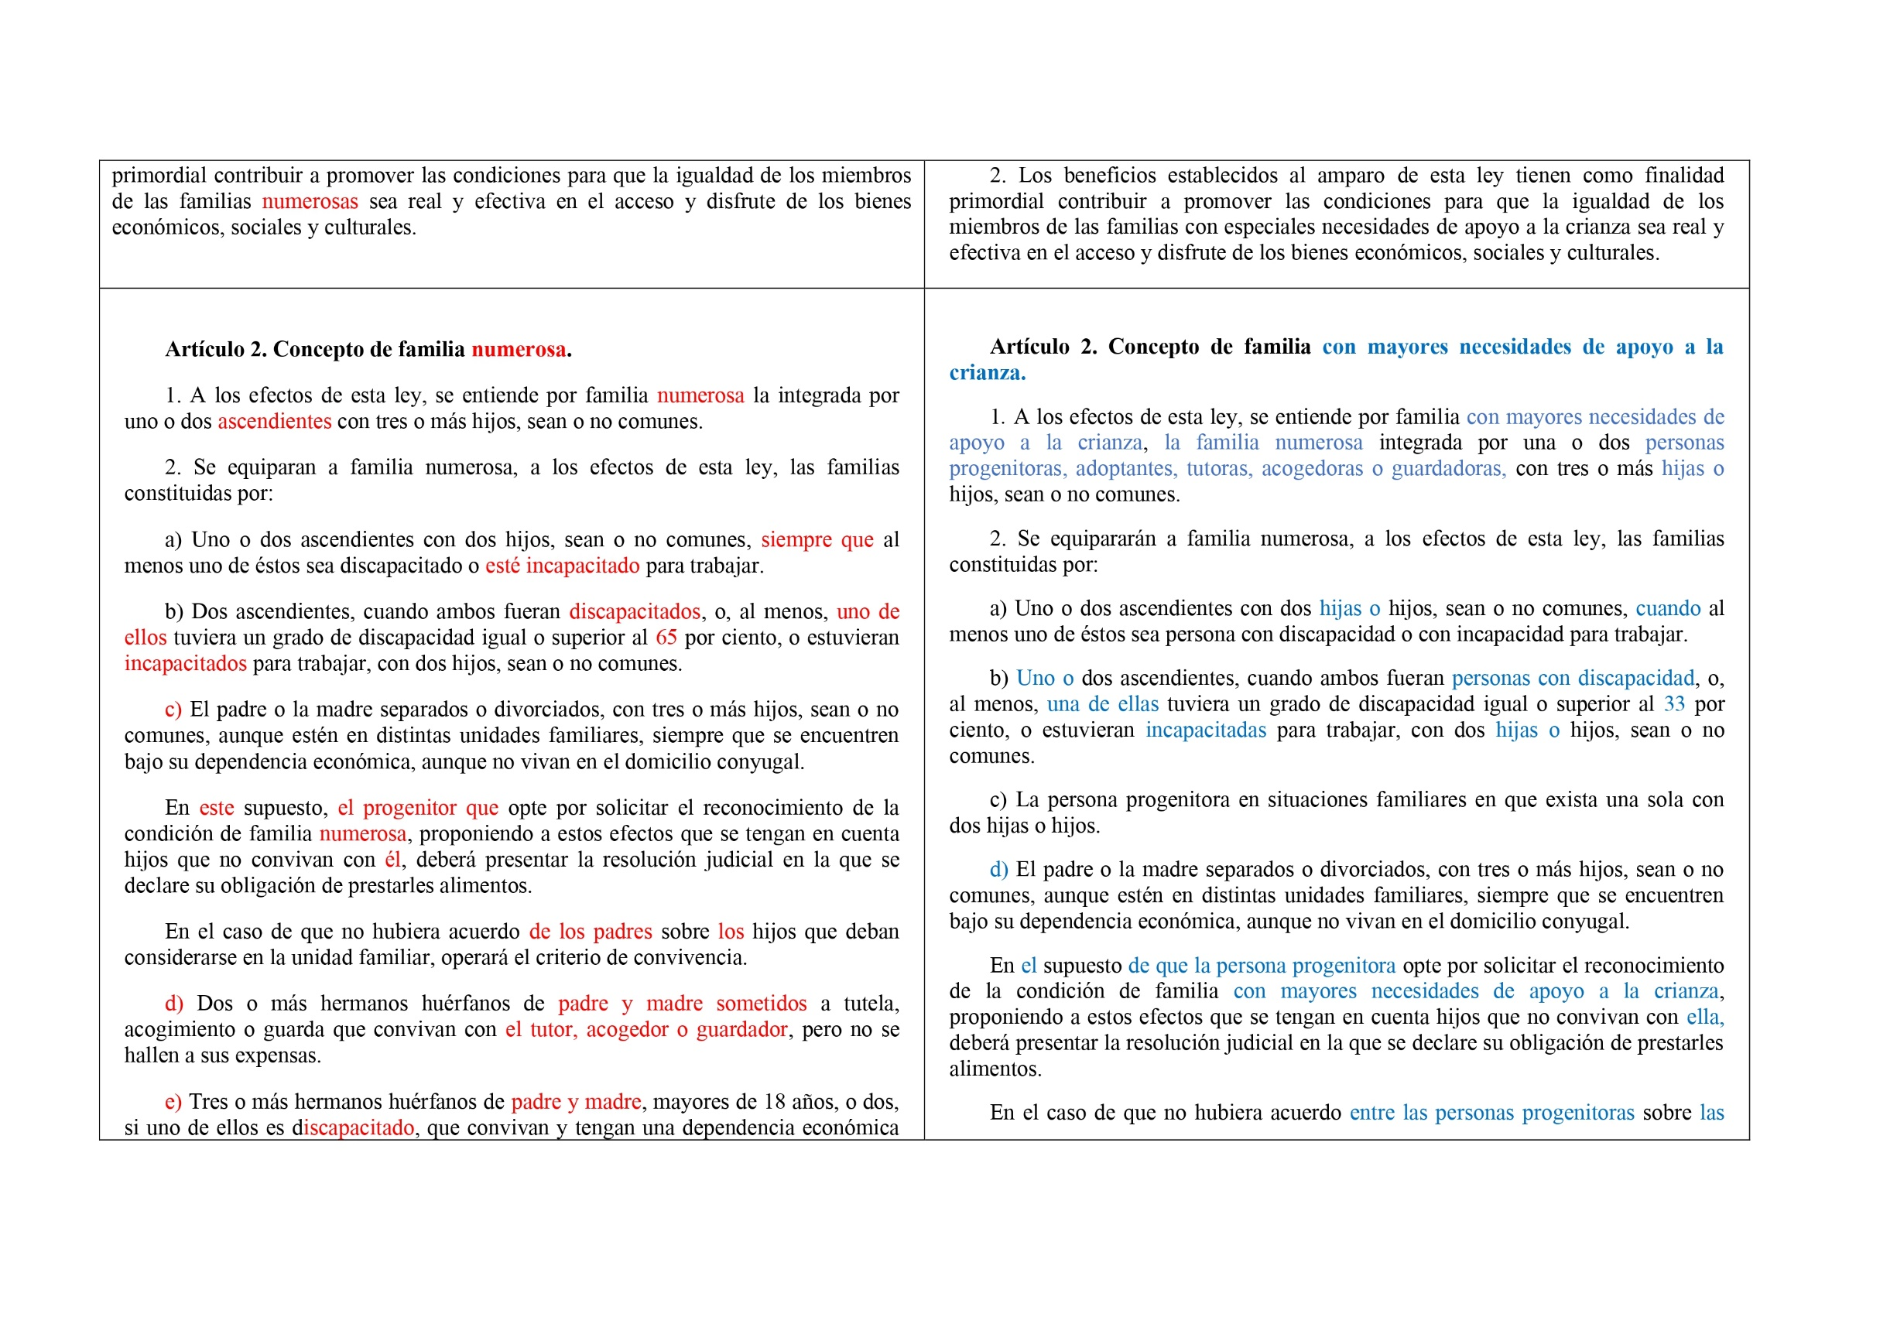
Comparative documents
Working documents
Consolidated texts and
legislative changes proposed in the bill
The parts of the text to be eliminated are highlighted in red, while those to be changed or newly introduced are written in blue
Comparative documents
Families Bill

Slide 19
Studies
Working documents
They include abstracts and summaries
They provide access to the full texts of the research studies, articles, etc. in the bibliography (in the version distributed inside the House)
They may be systematized ccording to the different aspects treated in the bill
Studies
Higher Artistic Education Bill

Slide 20
The new dossiers

Slide 21
Rhythms & needs
The new dossiers
The new rhythms of parliamentary activity caused the need of parliamentarians (and of their staff) to obtain the most relevant information quickly and in an immediate way, without the need of a further study of a wide range of material
Goals of the new model of dossiers
At a single glance, they should provide a clear and concise explanation and be able to inform about the key points of the bill and their regulation in comparative law.
At the same time, they should allow and provide guidelines for a deeper study through an extensive use of hypertext

Slide 22
Content: clarity and simplicity
The new dossiers
Simple and quick identification of the main points and general objectives of the bill
Dossier
Civil Service Bill
Dossier
Families Bill

Slide 23
Visually attractive presentations
The new dossiers
Dossier
Wildlife firefighters Bill
Dossier
Accidents and incidents Authority Bill

Slide 24
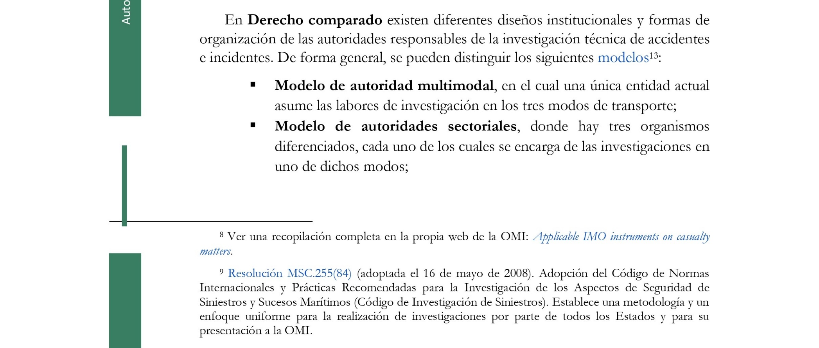
Comparative law classifications
The new dossiers
Dossier
Protection of journalistic secret Bill
Dossier
Accidents and incidents Authority Bill

Slide 25
Flexible arrangement and structure
The new dossiers
A new, flexible arrangement of the information, adjusted to the specific features of each bill
Suitable to the significant themantic diversity of many of the legislative initiatives

Slide 26
Outreach to citizens
Better display
Finally, the outreach to citizens was improved by a better display of the dossiers in the public website of Congress

Slide 27
Thank you for your attention

